Slide 1
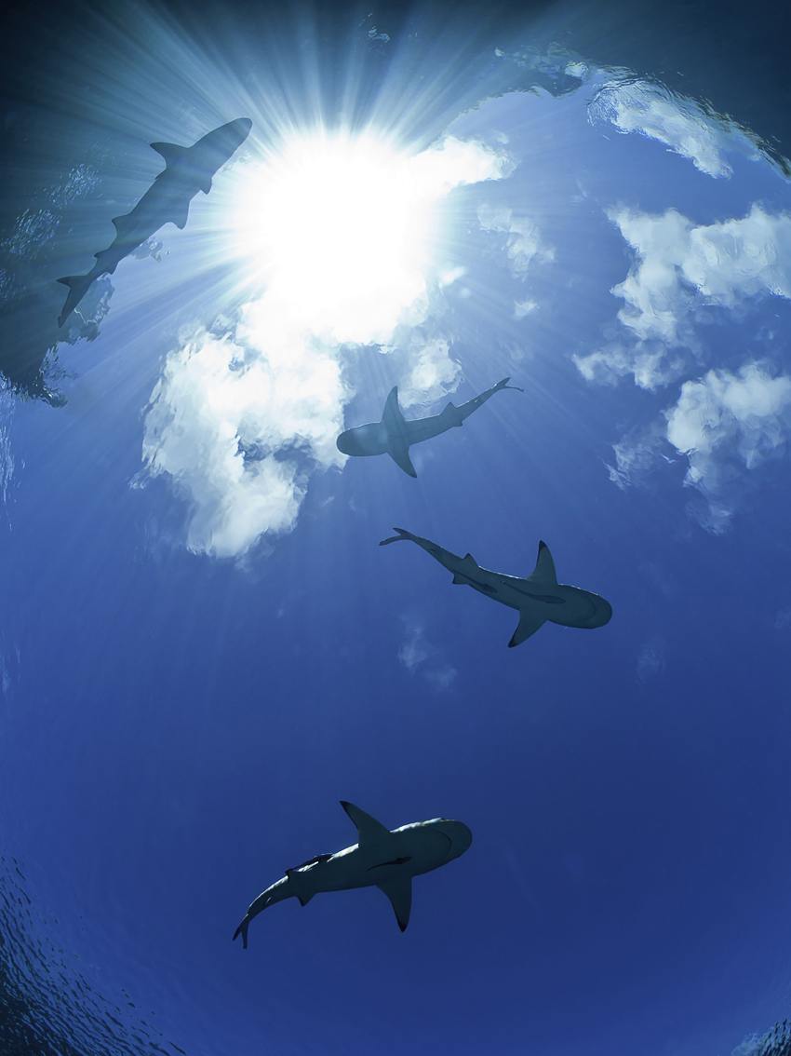






Evidence of fragmented reef shark populations in the insular Pacific
Thomas Vignaud
LABEX “CORAIL” - USR 3278 - CNRS – EPHE -
Centre de Recherche Insulaire et
Observatoire de l'Environnement (CRIOBE)
ICRS Session 13d : Reef sharks and coral reefs

Slide 2
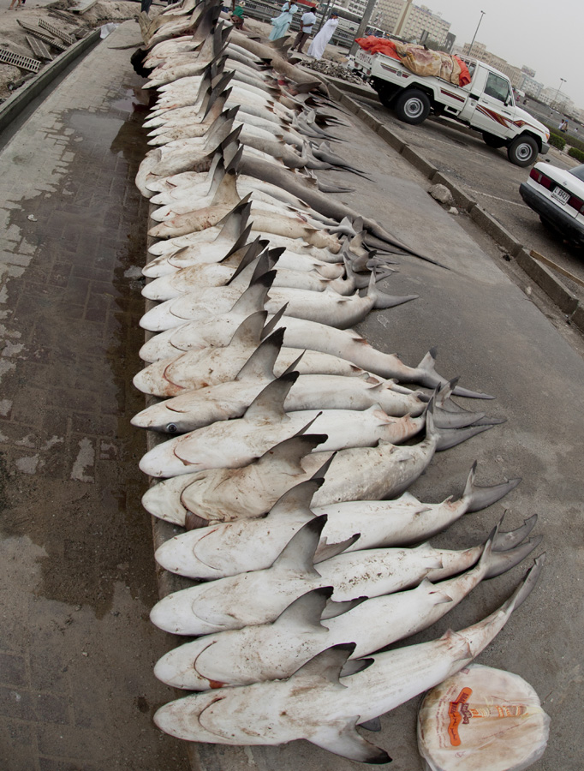
« The Shark Drama »
Sharks are keystone species
BUT
Fragile :
Slow reproduction
Easy to catch
~ “K” Strategy
Sensitive to exploitation
AND
Overexploited
Environmental degradations
-> Sharks are among the most endangered species

Slide 3
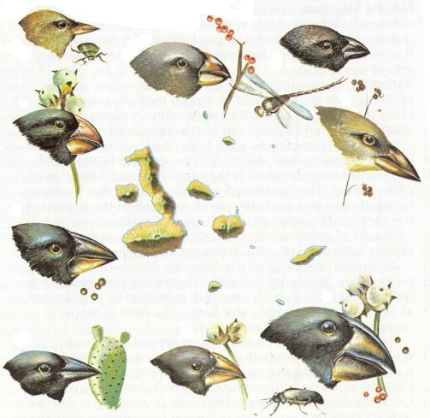
Why connectivity matters
It is critical to understand the connectivity of populations to
Properly design marine reserve networks
Make informed decisions about global species management
Connectivity strongly influences evolution process ( local adaptation, natural selection process, …)
To know more : i.e. McCook et al. 2009, Botsford et al. 2009
Darwin’s Galapagos finches

Slide 4
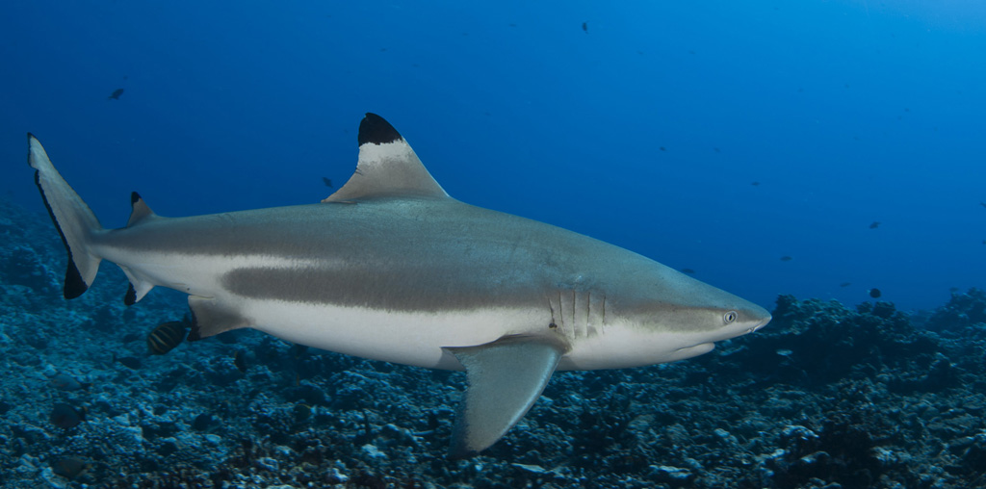
The blacktip reef shark – Carcharhinus melanopterus
Small (<160 TL), coral reef associated, active swimming species.
Sometimes forming small groups.
Red Sea, Indian and Pacific Ocean, between 30°N-30°S.
Easy to work on in some places : many individuals easy to fish from the shore, very resistant and easy to manipulate.

Slide 5
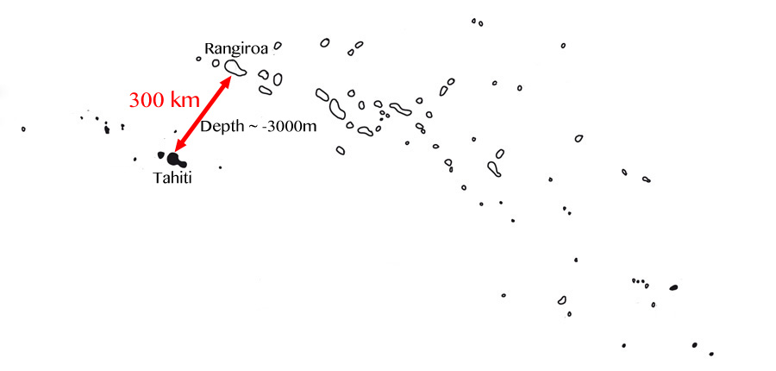
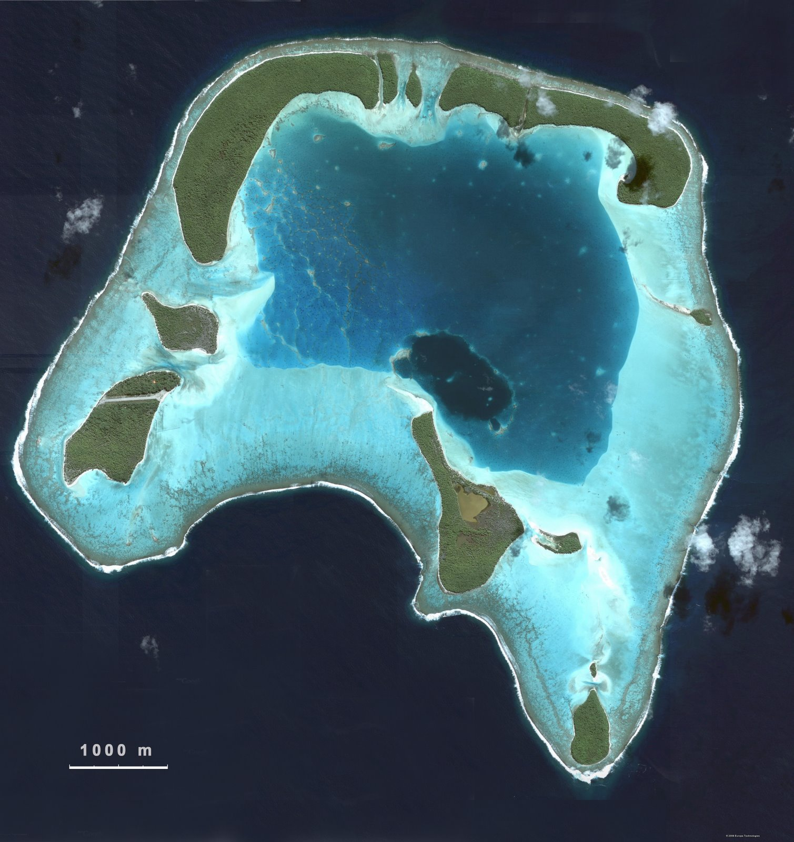
French Polynesia – a fragmented system
The example of Tetiaroa : a small atoll surrounded by deep-sea open waters.

Slide 6
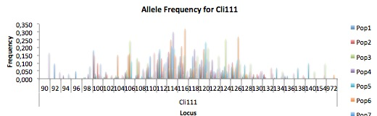
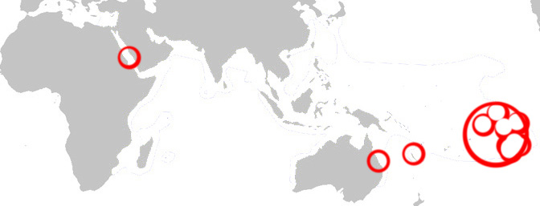
Genetic connectivity
17 microsatellites loci.
11 Geographic clusters in French Polynesia.
3 additional Geographic clusters :
- Red Sea
- West Australia
- New Caledonia

Slide 7
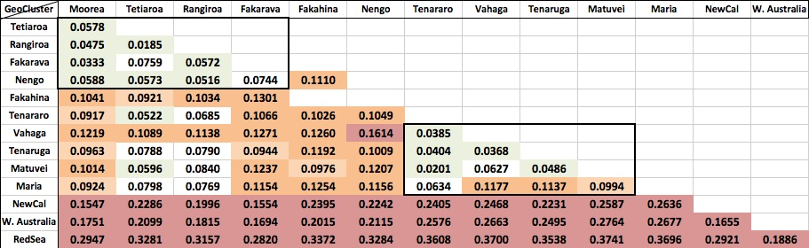
Firsts results
Pairwise F_{ST} values
Results from Genepop
Convention on F_{ST} values :
0 - 0.05 : little differentiation
0.05 - 0.15 : moderate differentiation
0.15 - 0.25 : great differentiation
0.25 : very great differentiation
(Wright 1978; Hartl & Clark 1997)

Slide 8
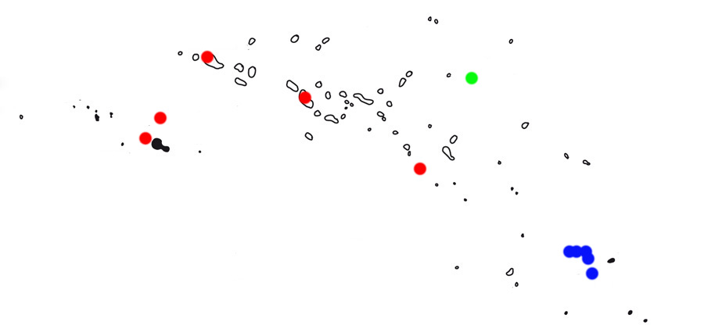
Map of French Polynesia
Rangiroa
Fakahina
Tetiaroa
Fakarava
Moorea
Nengo
Actéons
Maria

Slide 9
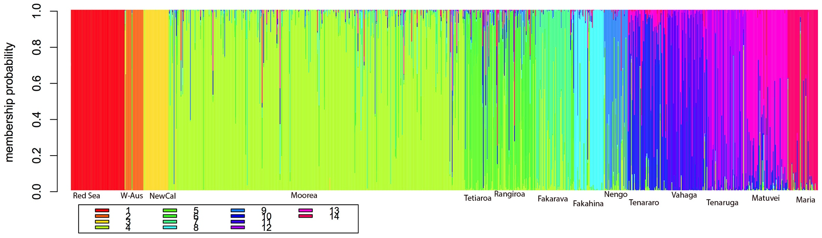
Bayesian approach
Adegenet generated compoplot for all clusters
Actéons from Northwest to Southeast

Slide 10
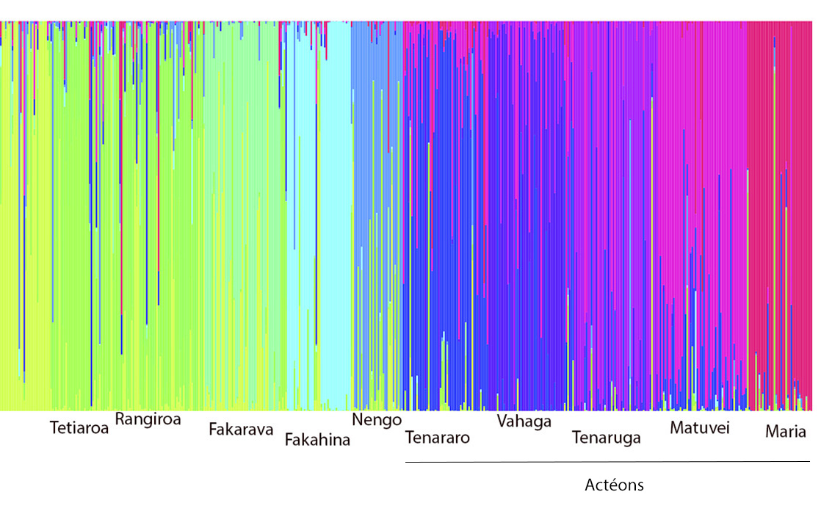
Crop from the Previous Compoplot

Slide 11
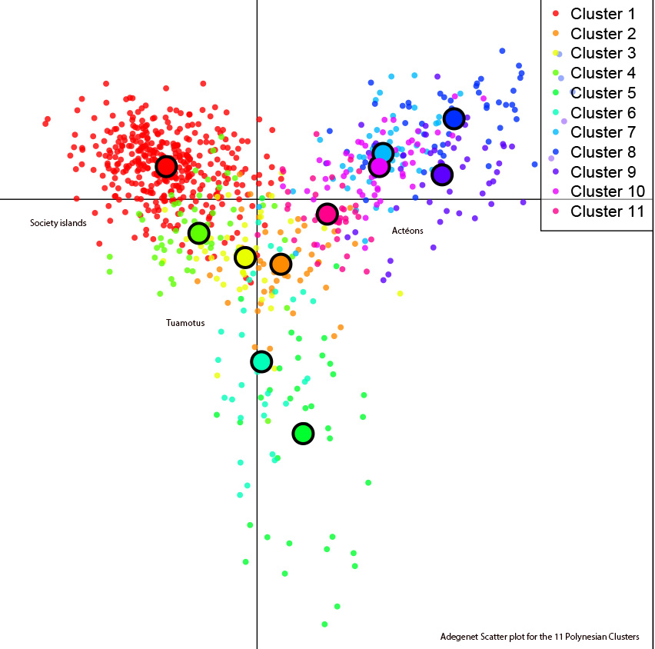
French Polynesia Scatter-Plot

Slide 12
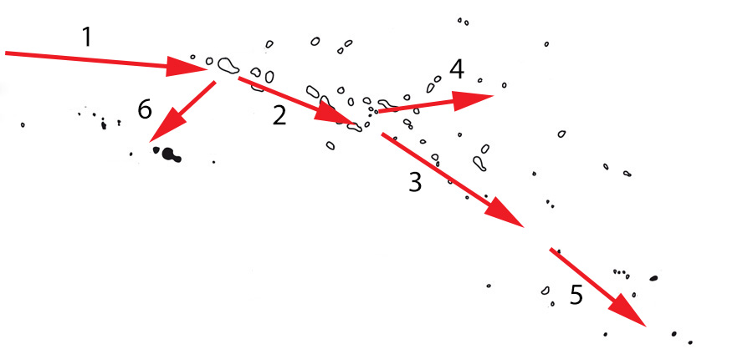
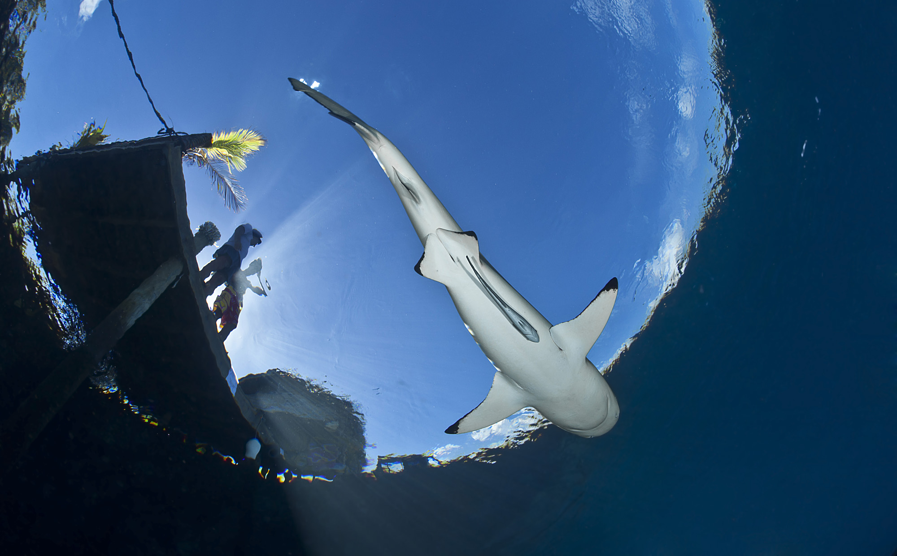
A limited connectivity
Needs for self-sustainability in each population
( = in each geographic cluster ? ( = worldwide ? ))
Taking into account differences between shark species
?
Next steps ?
Historical component ? Bottlenecks?
Isolation by Distance… or “Isolation by Isolation”
Who moves ? How/When ? (“why” ?)

Slide 13
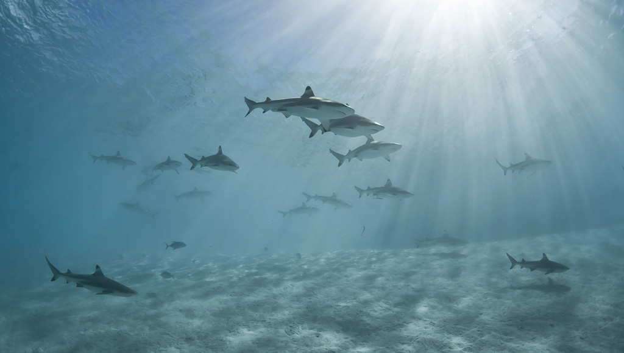

Thank you !
LABEX CORAIL – CRIOBE
CNRS – EPHE
Supervisor : Serge Planes
Special thanks to Save Our Seas Foundation for
extra funding to attend the ICRS
Providing samples and/or help on the field :
Johann Mourier
Eric Clua
Jennifer Ovenden
Julia Spaet

